Slide 1

Chapter 2:
The Philippines in the 19th Century as Rizal’s Context

Slide 2
"The facts of contemporary history are also the facts about the success and the failure of individual men and women,"
Wright Mills 1959

Slide 3
Means that the events and developments in the world at a given time are not just about big historical movements or abstract concepts. They are also intimately connected to the achievements and failures of individual people.

Slide 4
Coverage of Chapter II:
I. The World and the Philippines of Rizal Time
II. Understanding rizal in the context of the 19th Century Philippines

Slide 5
The 19th Century was not just about people struggling against colonial rule, it was about:
Filipinos
Men and Women alike
Fighting against political oppression

Slide 6
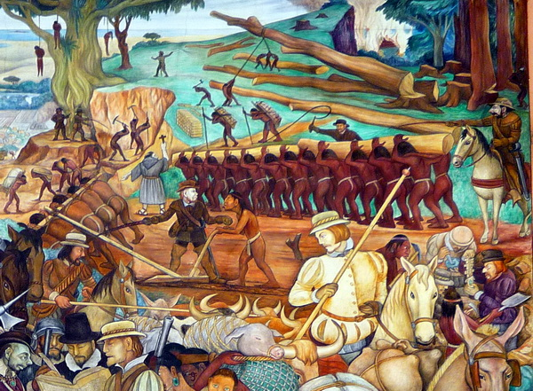
Philippines as a colony of spain, suffered from the instability of the Spanish colonial government.

Slide 7
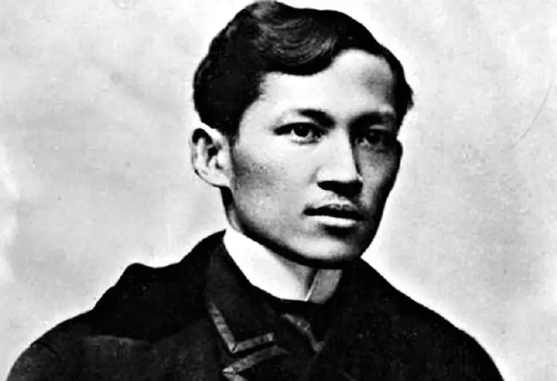
PAPYRUS HISTORY LESSON Infographics
Rizal together with the Filipino, fought bravely to change the Philippines political, economic, and socio-cultural conditions in the nineteenth century.

Slide 8
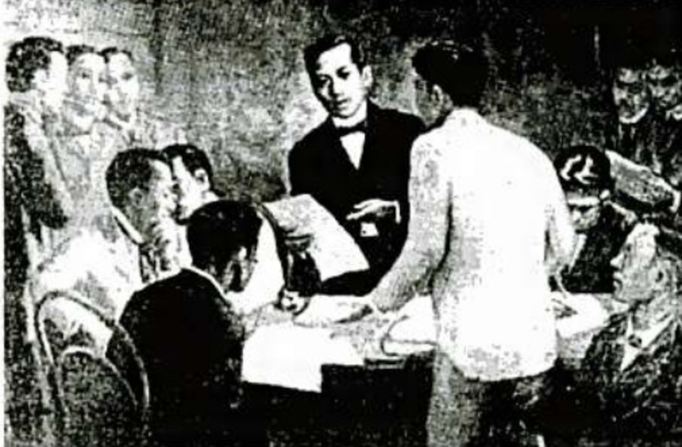
His response made him the center of the nationalist movement of his day and the principal inspiration of the Revolution
- Schumacher
1991

Slide 9

What was the World like in Rizal’s time?

Slide 10
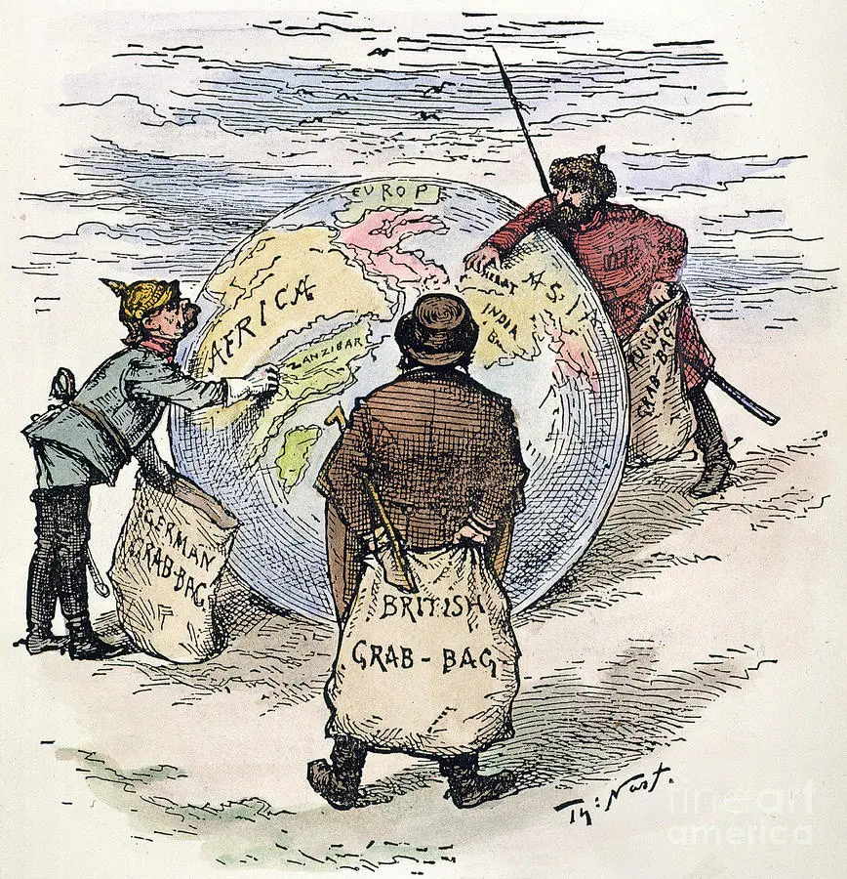
The world was characterized by widespread imperialism and colonialism, with European powers dominating and exploiting many regions around the globe.

Slide 11
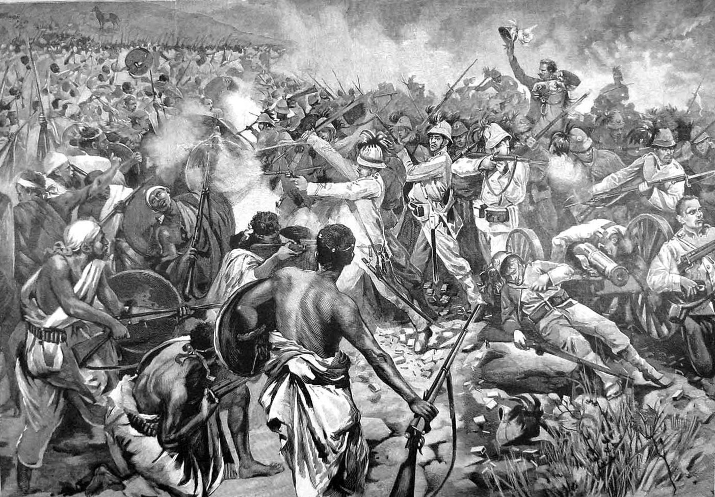
In the Philippines specifically, it was a Spanish colony, marked by a rigid caste system, social inequality, and resistance movements against colonial rule.

Slide 12
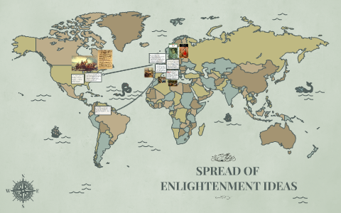
This period also witnessed the spread of Enlightenment ideas and the emergence of nationalism and independence movements in various parts of the world.

Slide 13
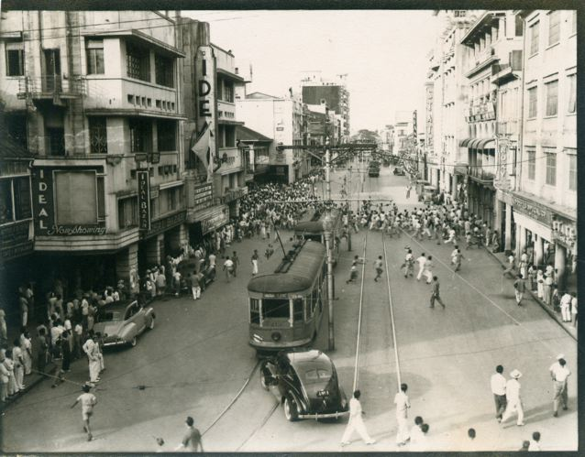
What was the Philippines in Rizal’s time?
What was the Philippines in Rizal’s time?

Slide 14
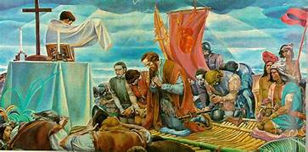
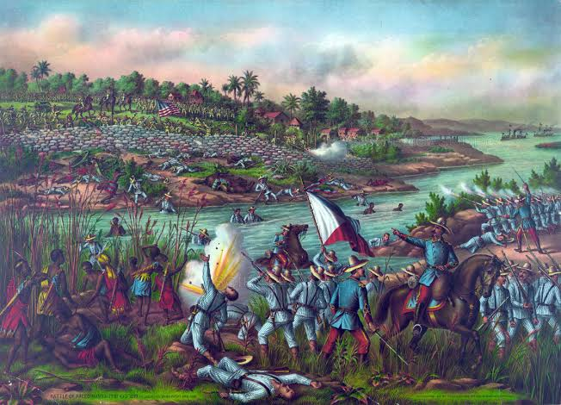
Philippines was a colony of Spain, characterized by Spanish colonial rule, a hierarchical society, and a strong influence of Spanish culture and religion

Slide 15
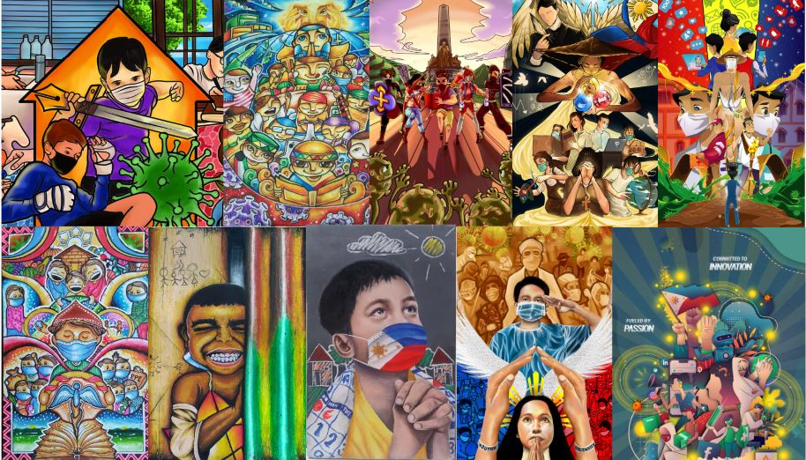
The World and the Philippines of Rizal’s Time

Slide 16
In 19th century, there were massive changes in the world, particularly in Europe, Spain, and the Philippines.
(1858-1863)
Europe prospered like never before and England led the way as the growing imperialist power.

Slide 17
France conquered Vietnam, Cambodia and Laos
While the 19th Century was hailed for its massive social changes, it was not for all imperialists.
While England, France and Dutch enjoyed the fruits of their colonial activities, Spain Stagnated.

Slide 18
Spain never learned a lesson from the loss of her colonies
(Zaide, 1999)
From being considered the “Mistress of the world”, Spain continued despotic colonial rule in its remaining colonies- Cuba, Puerto Rico and the Philippines.

Slide 19
During this time, Rizal witnessed the flowering of Western imperialism and the downfall of the Spanish colonial rule.

Slide 20
In this century, Rizal was born and exposed to varying political, economic and socio-cultural realities
Rizal witnessed the effects brought by the industrial Revolution, benefited from the opening of the Suez Canal, gained education in Europe, became an Ilustrado, and took part in the Propaganda Movement.

Slide 21
The constant shift of these political policies disrupted the way Spain governed the Philippines:
There was maladministration in the delivery of justice

Slide 22
Here are some of the consequences and impacts on Filipinos during this period:
Unequal Treatment:
Filipinos often received unequal treatment before the law compared to Spanish colonizers and the Spanish elite. This unequal treatment eroded trust in the justice system and fostered resentment.
Abuses by Spanish Friars:
Spanish friars, who held significant power in the Philippines, sometimes manipulated the legal system to protect their interests and suppress dissent. This included cases of land grabs and the persecution of those who challenged religious authority.

Slide 23
II: There was no Equality before the Law
In the Philippine context in the 19th century, the native nobles and pure-bred Spaniards enjoyed legal preference both in law and social duties.

Slide 24
III: Racial Prejudice against native Filipinos became prevalent.
As evident by the words of Father Burgos, who is known for taking an active part in the Secularization Movement, he provided unequivocal evidence of how racial discrimination was prevalent even among the native clergies.

Slide 25
IV: The Mandatory exercise of forced labor oppressed the Filipinos Further.
Also known as POLO Y SERVICIO, all Filipino males with ages ranging from 16-60 were required to render forced labor by the Spanish Government. The workers were called POLISTAS, while mandatory labor itself was called POLO.

Slide 26
Economic Context
The second half of the 19th century was a period of rapid economic growth.

Slide 27
ODENSE,2006
In Europe, the use of increasingly expensive, powerful and productive steam engines resulted in the use of machinery in the manufacturing sector in the cities of Europe.

Slide 28
SUEZ CANAL
Is a waterway that connects Europe to Asia by creating a direct shipping route without having to circumnavigate the African continent.

Slide 29
The opening of Suez Canal brought several advantages and disadvantages to the Philippines:
The distance of travel between Europe and the Philippines was significantly shortened.
It brought the country closer to spain .

Slide 30
SOCIO CULTURAL CONTEXT
The 19th Century also brought socio- cultural changes in Spain and the Philippines.
They came the rise of the enlightenment period
Saw the rise of middle-class , the principalias.

Slide 31
To enhance their trading capacities , Spain implemented the following measures:
Reformation of the Galleon Trade
Settlement of the Spaniards in the provinces for agricultural and trade purposes
Government expropriation to the landed estates of the friar corporations

Slide 32
Understanding Rizal in the Context of the 19th Century Philippines

Slide 33
The political, economic and social conditions of the 19th century shaped the kind of Rizal that we know today in history.

Slide 34
Schumacher 1991
The political, economic, and societal conditions of the 19th century sheped the kind of Rizal that we know today in history. Without an understanding of the milieu, one can scarcely understand Rizal,s enduring importance to the filipino people nor the relevance of his ideas and ideals today.

Slide 35
To know why Rizal fought for reforms, one must look into the political conditions of the 19th century to understand the political struggles of the Filipinos.

Slide 36
To know why Rizal fought against the Spaniards, one must assess how the Spanish Government exploited the Filipinos through their economic policies.

Slide 37
To determine why Rizal attacked the friars in his novels, one must understand the social realities of the filipinos during his time.

Slide 38
Would Rizal be who he is today if the Philippine context in the 19th century were different?

Slide 39
Definitely, YES

Slide 40
The kind of Rizal that we know today is a product of his own time . He was at the right time, with the right people, and with the right context to campaign for nationalism.

Slide 41
We cannot seemingly imagine a 19th century Philippines without someone like Rizal on it.

Slide 42
The independence that we have today is the result of how Rizal, together with other Filipino heroes in history, fought hard to achieve the blessings of independence and democracy.

Slide 43
THANK
YOU!!

